Slide 1
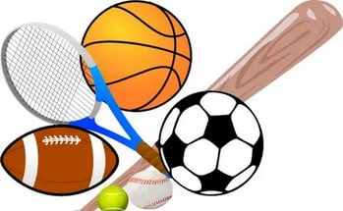
Sport in our life
"A sound mind is
in a sound body"
ancient Greek

Slide 2
Match the words in English and in Russian.
Roller-skating | Катание на роликах
Skiing | Плавание
Swimming | Гибкий
Hiking | Велоспорт
Cycling | Катание на коньках
Skating | Катание на лыжах
Tournament | Горный туризм
Improve | Мускулы
Keep fit | Улучшать
Muscles | Турнир
Flexible | Быть в хорошей форме

Slide 3
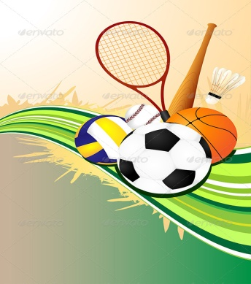
Group these activities into indoor and outdoor sports.
sailing
skating
surfing
baseball
diving
bowling
tennis
handball
horse-racing
wrestling
ice hockey
archery
volleyball
Indoor
sports
Outdoor
sports

Slide 4
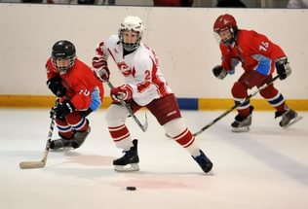
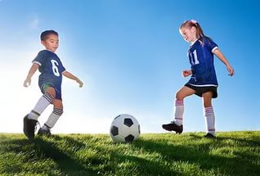
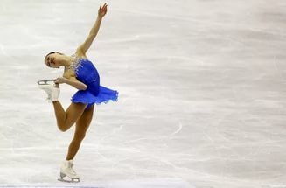
What kinds of sports are popular in Russia?
skating
football
hockey

Slide 5
Answer the questions:
Are you against or for sports?
Do you prefer going in for sports or watching it on TV?
Is sport a part of our everyday life?
Is sport important to you?
What is your favourite kind of sport?
Who is the best sportsman in your class?

Slide 6
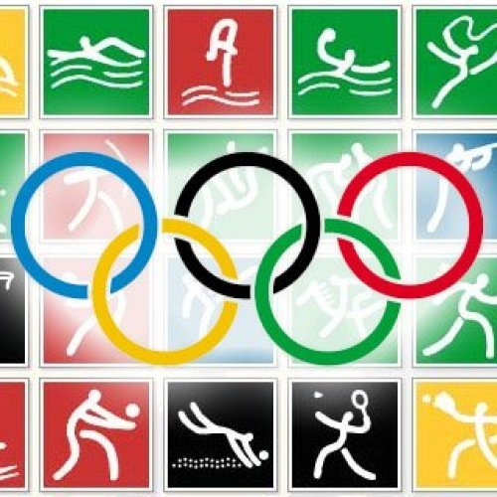
How do we call people who:
    play football swimmer
    cricket cyclist
    tennis runner
    go swimming footballer
    jumping surfer
    running tennis player
    windsurfing jumper
    ride a bike batsman

Slide 7

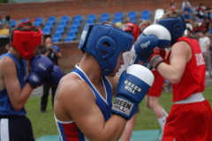





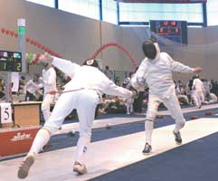
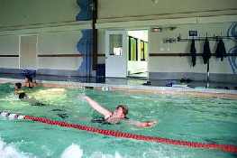
Complete the chart by matching each sport with the place and equipment which go with it.
sport place equipment
boots
costume
pool
ring
slope
skis
boat
racket
stadium
rink
oar rod
court
ball
gloves
river
alley
pitch
hoop

Slide 8
Guess what kind of sports it is. Translate the sentences into Russian.
It is a game for two or four players
who hit a ball with rackets across a net.
It is a summer game played on a grass field
by two teams with a ball, bats and wickets.
It is a game played by two or four persons
with a small hard ball
which is struck with clubs into holes.
It is a way of traveling or going on foot.
It is a team game played with oval ball.
It is a game played on a table
using round wood bats and a small plastic ball.

Slide 9










Write the correct name of the day under each bag.
On Saturday
and Sunday
mornings
On Mondays
On Wednesdays
Every day
On Sunday
afternoon
On Mondays
On Friday evening

